Slide 1
Diversity, equity and inclusion
Session 2b
Equity and Covid 19

Slide 2
Session 2b Objectives

Slide 3
Essential Principles for this Learning Community

Slide 4
Crises Collide – Gender & COVID 19
In the UK, women are the majority of frontline workers (77%), the majority of low paid (69%), and the majority of people with caring responsibilities, paid and unpaid. (LSE)
Women face a slightly higher likelihood than comparable men of losing their jobs and/or report lower earnings. All factors considered, it seems therefore that – unlike previous recessions – the current crisis is harming women’s labour market prospects more than those of men.
The closure of schools and the gender dynamics of child care and home production also impact women more greatly. This is also true to the data around single parents the majority of who are women and are facing greater job insecurity
Women are the majority of people living in poverty and female-headed households are more likely to be poor. For example, 45% of lone parents (90% of whom are women) are living in poverty.
There are huge gaps in the Government’s salary retention schemes for employees and self employed, which particularly affect women. Pregnant women are at risk of discrimination and millions will fall through the net or be made redundant anyway.

Slide 5
Crises Collide – Gender & COVID 19
The UK’s largest domestic abuse charity, Refuge, has reported a 700% increase in calls to its helpline in a single day, while a separate helpline for perpetrators of domestic abuse seeking help to change their behaviour received 25% more calls after the start of the Covid-19 lockdown.
At least 16 suspected domestic abuse killings in the UK have been identified by campaigners since the Covid-19 lockdown restrictions were imposed, far higher than the average rate for the time of year
The housing affordability gender gap in the UK is a clear example of pre-existing inequalities: on average in England: average rents take 43% of women’s median earnings but just 28% of men’s
Already, 67% of statutory homeless people are women and housing unaffordability is also closely linked with violence and abuse
Black, Asian and Ethnic Minority women are three times more likely to be in precarious work, so the are less likely to qualify for furlough or Statutory Sick Pay.

Slide 6
ONS - COVID 19 & Disability
Almost half (45.1%) of disabled adults, compared with around a third (30.2%) of non-disabled adults, reported being very worried about the effect the coronavirus (COVID-19) pandemic is having on their life. Nearly 9 in 10 disabled adults (86.3%) reported they are very worried or somewhat worried.
Nearly two-thirds (64.8%) of disabled adults said COVID-19-related concerns were affecting their well-being.
Disabled adults were significantly more likely than non-disabled adults to report spending too much time alone; around a third (35.0%) of disabled adults reported this compared to a fifth (19.9%) of non-disabled adults.
Finding a way to stay in touch with friends and family remotely is the most popular action that is helping people cope while staying at home; however, spending time with members of their household was a less frequent form of coping for disabled (41.9%) than non-disabled adults (63.5%).

Slide 7
RiDC & GDA Surveys
Only one in five disabled and older people feel the government is doing enough to support them during the Covid-19 outbreak.
50% of people with care support needs are no longer receiving health or personal care visits to their home.
Of the 47% of respondents who have used online shopping during the crisis, 45% believe the supermarkets are performing poorly or very poorly.
In a survey by Glasgow Disability Alliance only just over a third of disabled people reported having home broadband during the pandemic.
One in 10 adults with a disability reported often or always feeling lonely in the last seven days, according to the ONS, compared with less than one in 20 non-disabled adults.

Slide 8
Institute of Fiscal Studies – Race & COVID 19
Per-capita COVID-19 hospital deaths are highest among the black Caribbean population and three times those of the white British majority.
Once you take account of age and geography, most minority groups ‘should’ have fewer deaths per capita than the white British majority.
After accounting for the age, gender and geographic profiles of ethnic groups, inequalities in mortality relative to the white British majority are therefore more stark for most minority groups than they first appear.
After stripping out the role of age and geography, Bangladeshi hospital fatalities are twice those of the white British group, Pakistani deaths are 2.9 times as high and black African deaths 3.7 times as high
More than two in ten black African women of working age are employed in health and social care roles. Indian men are 150% more likely to work in health or social care roles than their white British counterparts.
At-risk underlying health conditions are especially prevalent among older Bangladeshis, Pakistanis and black Caribbeans.

Slide 9
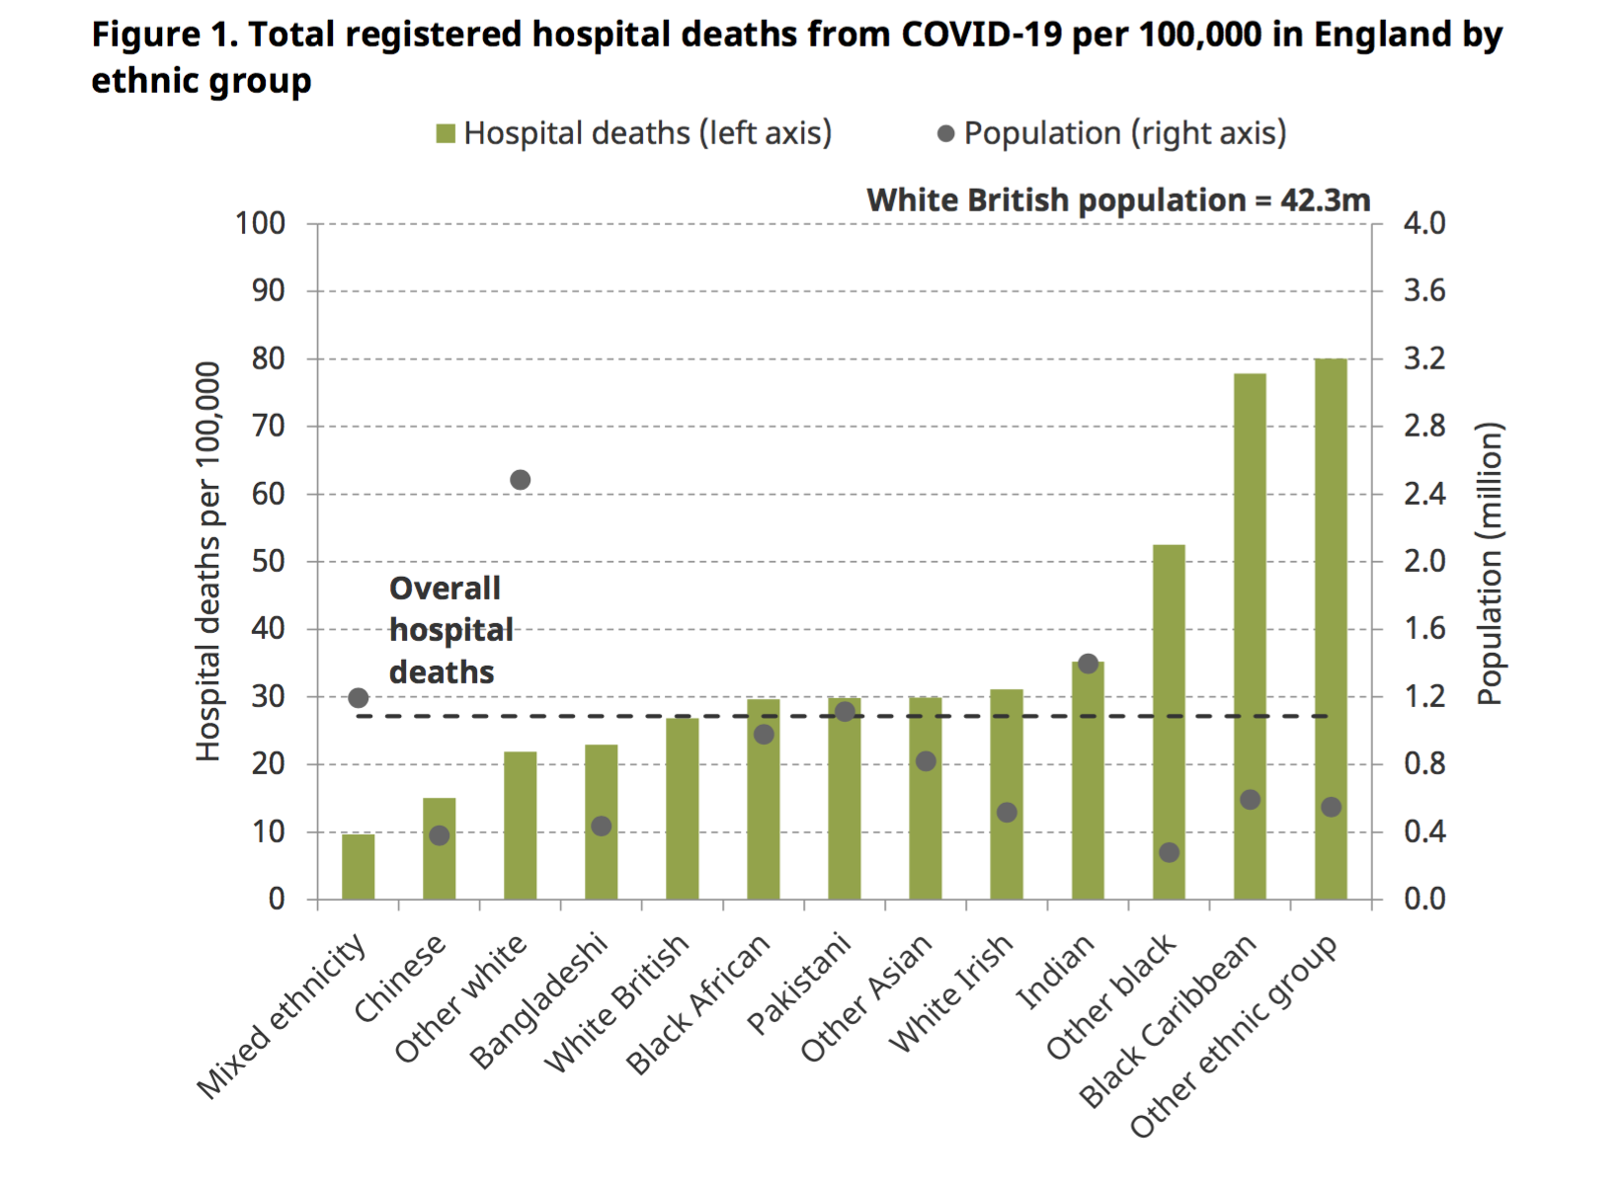

Slide 10
Institute of Fiscal Studies – Race & COVID 19
Many ethnic minorities are also more economically vulnerable to the current crisis than are white ethnic groups.
Men from minority groups are more likely to be affected by the shutdown. Bangladeshi men are four times as likely as white British men to have jobs in shut-down industries, and Pakistani men are nearly three times as likely. Black African and black Caribbean men are both 50% more likely than white British men to be in shut-down sectors.
The potential for buffering incomes within the household depends on partners’ employment rates, which are much lower for Pakistani and Bangladeshi women.
Bangladeshis, black Caribbeans and black Africans also have the most limited savings to provide a financial buffer if laid off.

Slide 11
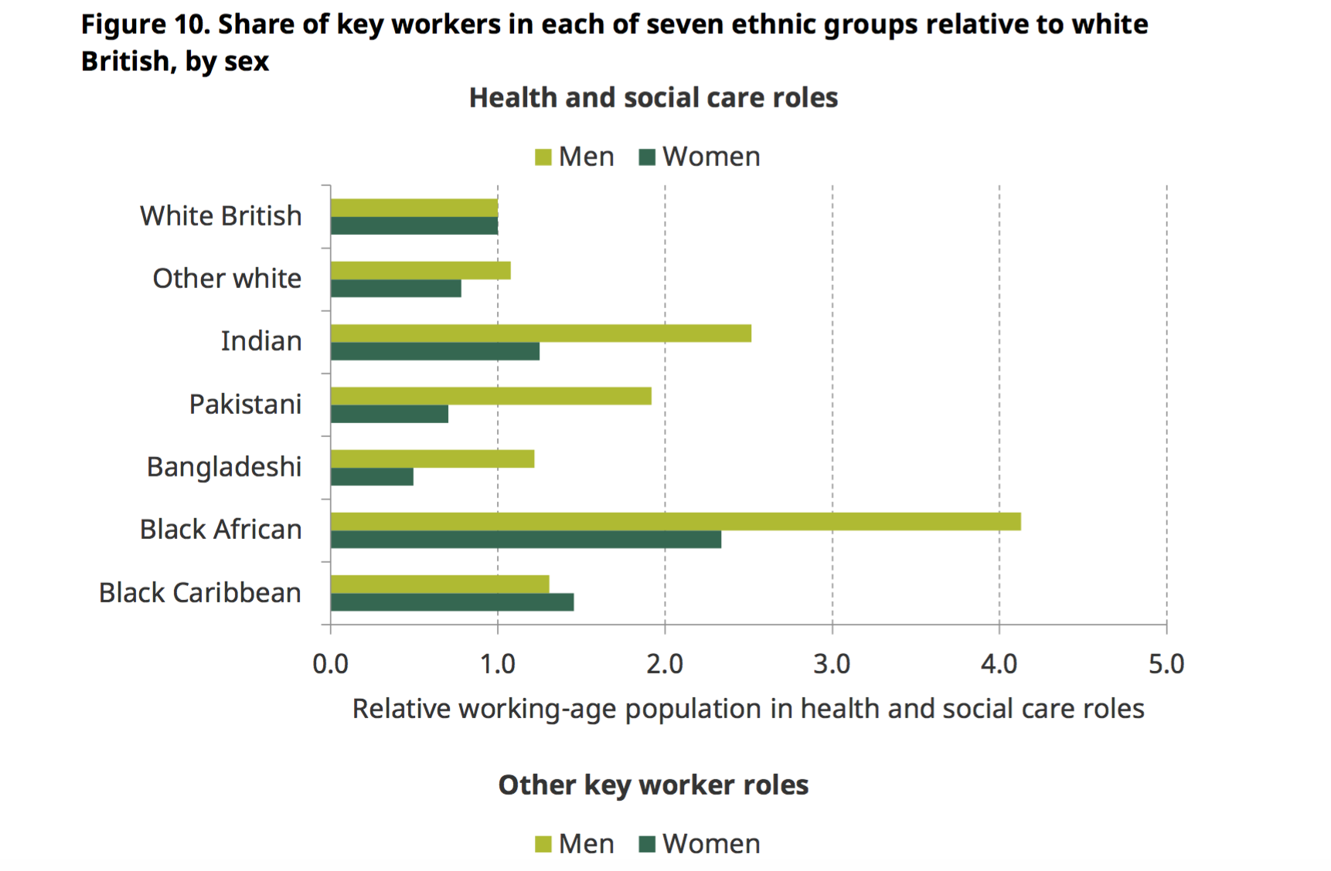

Slide 12
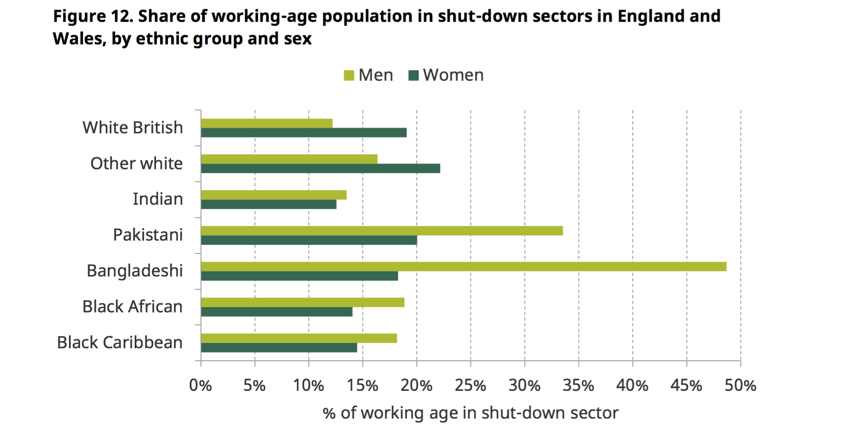

Slide 13
Ubele – Impacts of COVID-19 on the BAME Community and Voluntary Sector
Without support, many organisations may not be able to adapt as quickly as others, and as such, may find that they are at a stage where their work cannot continue; and for those able to adapt, they may find that they are in ‘crisis management’ mode which becomes their new ‘normal’.
Those organisations most affected are micro and small BAME organisations, that largely receive less than £10,000 and upwards to £100,000 per annum (87%).
Due to the size the majority did not therefore have any ‘reserves’ (68%) with only 19% having reserves covering 3 months. Taken together, if the crisis continues beyond the 3 months, then 87% (or 9 out of 10 organisations) could conceivably cease to operate after three months; and with it, a projected 15,000 to 20,000 users per week unable to access services.

Slide 14
Informal thoughts from community and grassroots organisations
Funding and power dynamics means that money granted by funders isn’t agile and responsive and organisations don’t have the relationships to access the support they need
Relationships and networks of trust can be biased. Money flowing to traditional intermediates and usual suspects who aren’t best placed to meet the needs of those most vulnerable and impacted by the virus
Panic and uncertainty leads to entrenched behaviours; whilst there are good intentions with the Covid response funds and emergency funding, many of these decisions are being made by with little community consultation
Due to inequity we are also seeing a loss of community leaders and with that the learning and knowledge they have
Many ‘informal groups’ do not have access to fund

Slide 15
In groups
Discussion 1 - What have you learnt through Covid 19 about inequality and equity
What did it confirm that you knew already
What did you learn that you didn’t know before
What assumptions did you have that have been challenged
How has this been shared and how could this be shared further
Discussion 2 – How do we address these patterns and what is our role as funders
What have you been doing in response – share what's worked and what hasn't
What could we be doing collectively in terms of how we learn and how we work

